Slide 1


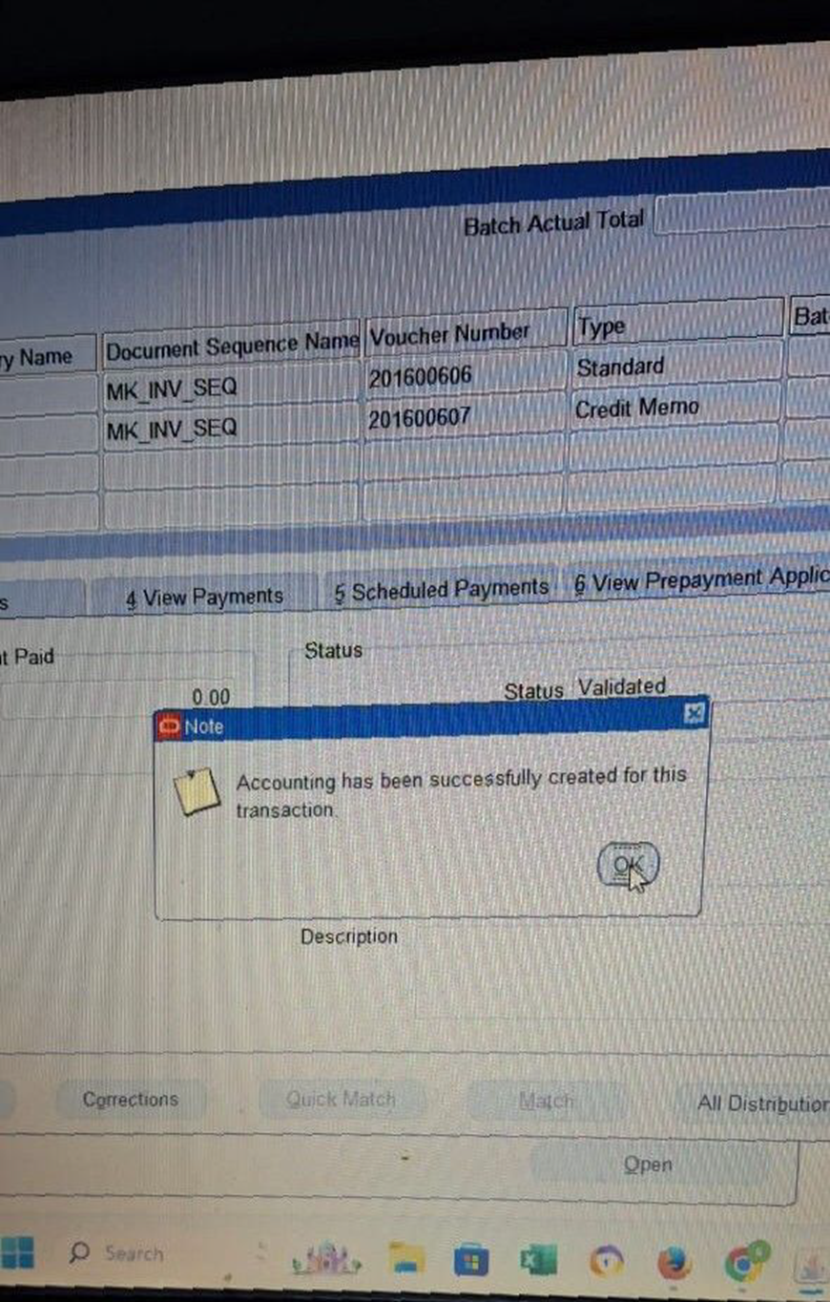
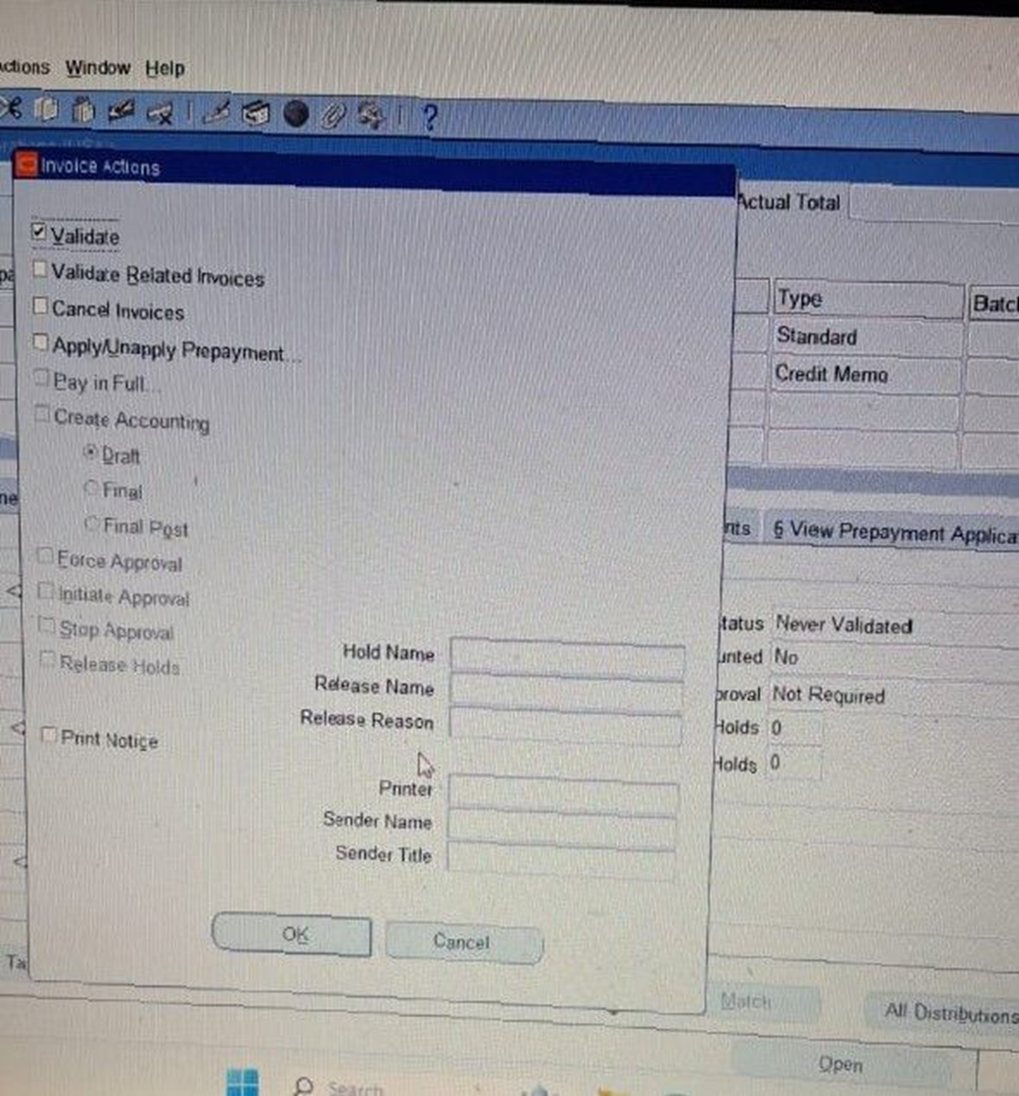
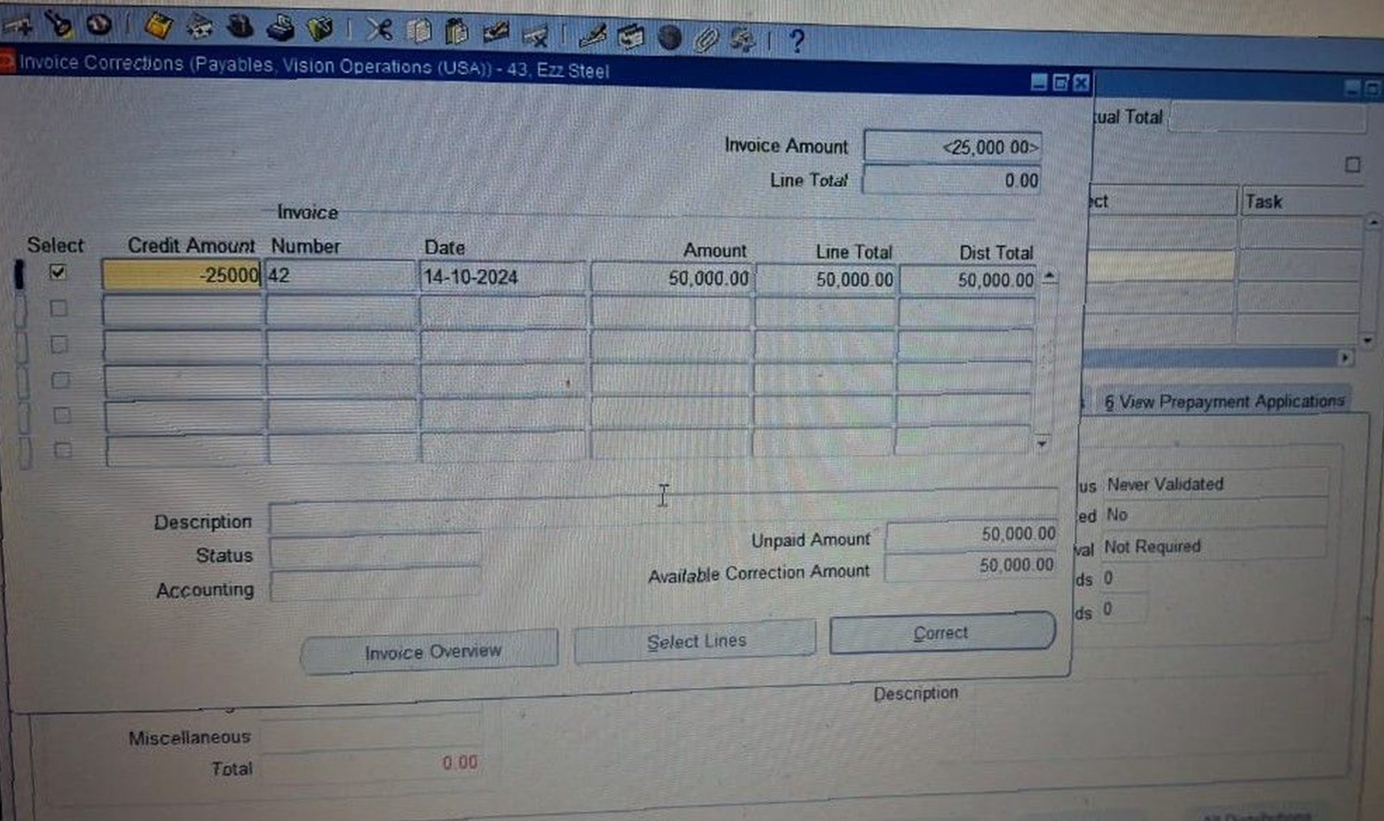
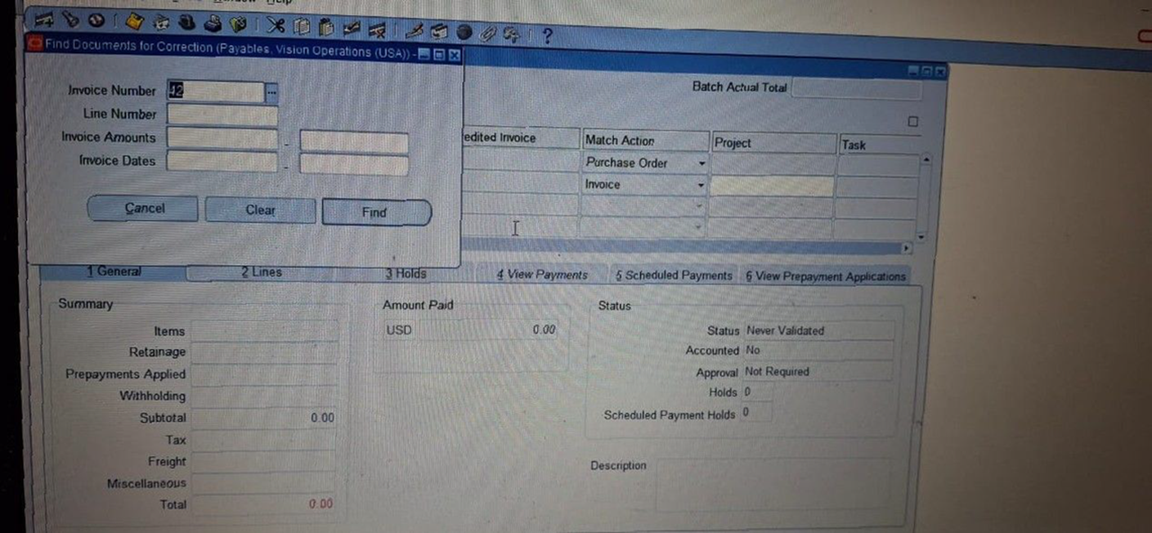
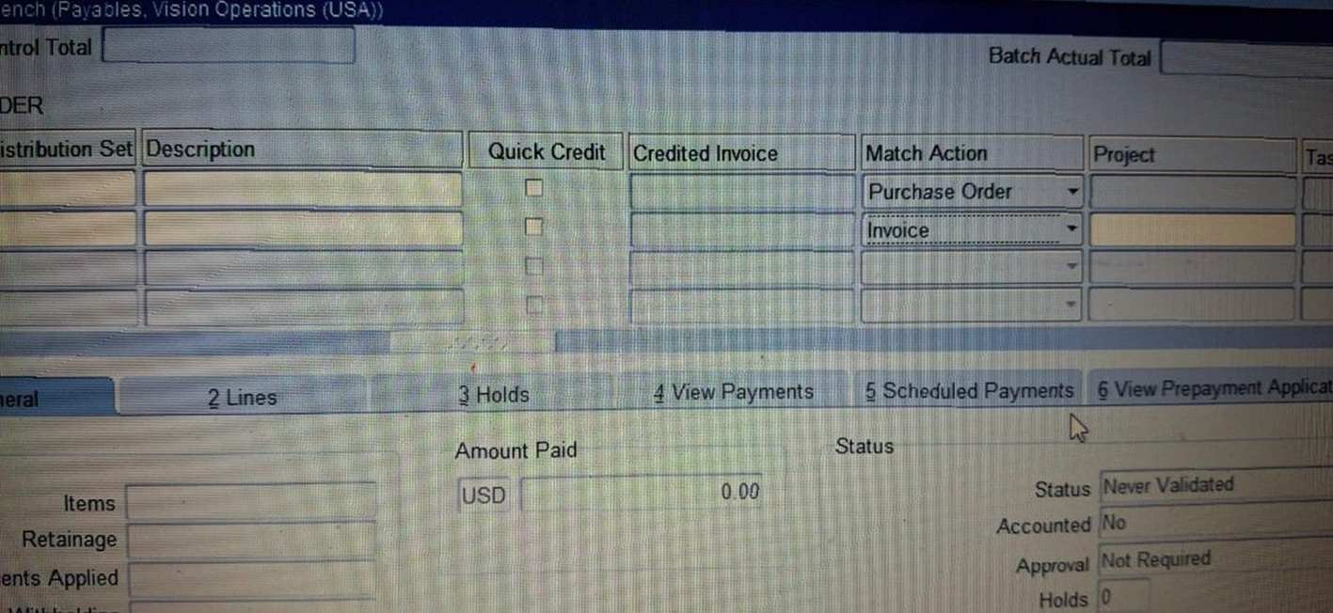
Create and Manage Supplier Invoices
Credit Memo
Match Action > Invoice> Correction
Find + the number of Invoice then OK
Click the Select then enter the Credit Amount
click correct > ok
Action > Validate
Action > Create Accounting > Final> OK
21

Slide 2
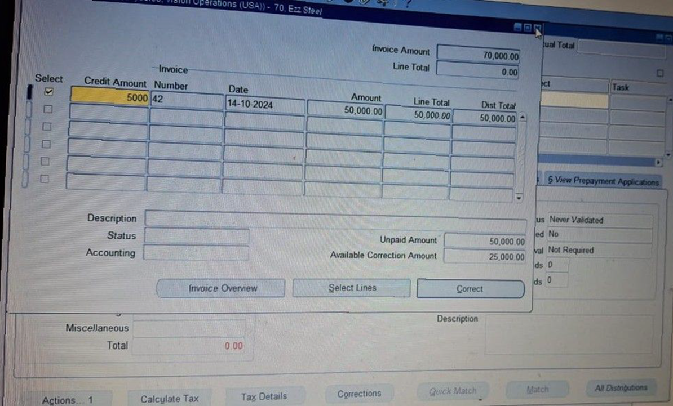
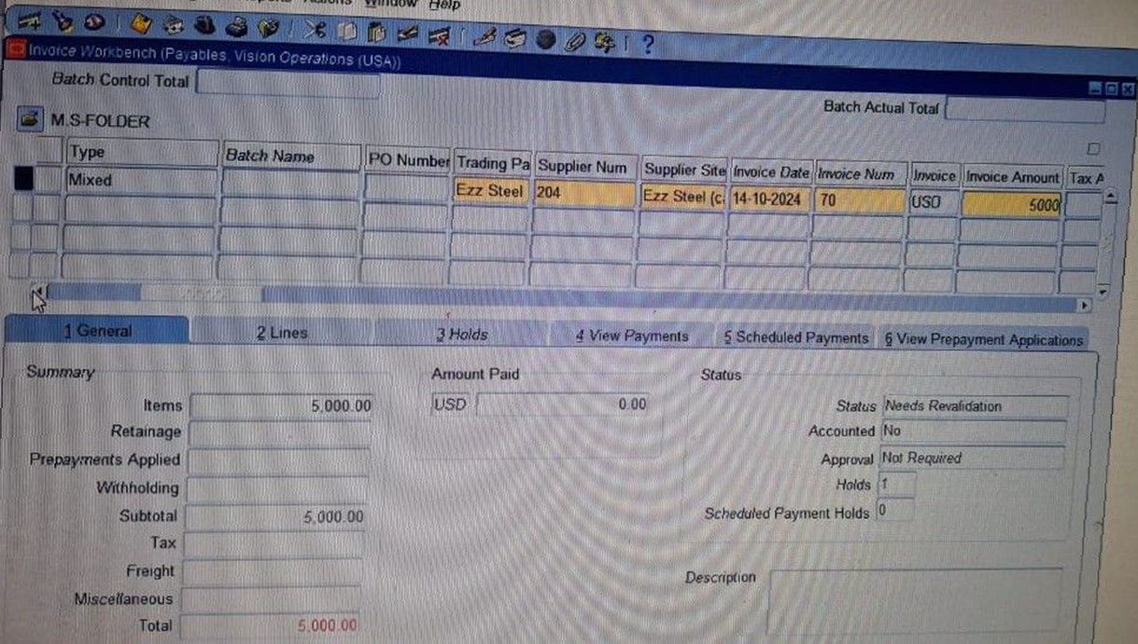
Create and Manage Supplier Invoices
Mixed Invoice
22

